Slide 1


Iael Perez
22/06/2022

Slide 2

Outline
Executive Summary
Introduction
Methodology
Results
Conclusion

Slide 3
Executive Summary
Summary of methodologies
Data collection using API and wrangling
Exploratory Data Analysis including SQL
Data Visualization (Graphs, Map with Folium and Dashboard with Plotly Dash)
Predictive Analysis
Summary of all results
Exploratory data analysis results
Interactive analytics demo in screenshots
Predictive analysis results

Slide 4
Introduction
Project background and context
The objective of this project is to predict if the Falcon 9 first stage will land successfully. SpaceX advertises Falcon 9 rocket launches on its website with a cost of 62 million dollars; other providers cost upward of 165 million dollars each, much of the savings is because SpaceX can reuse the first stage. Therefore, if it is determined that the first stage will land, it would be possible to determine the cost of a launch.
Problems you want to find answers
On which variables does the success of the first stage landing depend?
What is the relationship between rockets variables and the success or failure of a landing?
Based on the information available, how good are the predictions of landing success?

Slide 5

Section 1

Slide 6
Methodology
Executive Summary
Data collection methodology:
SpaceX REST API
Web scraping from Wiki pages
Perform data wrangling
Clean the original data (null values, irrelevant data)
One Hot Encoding
Perform exploratory data analysis (EDA) using different visualization tools and SQL
Perform interactive visual analytics using Folium and Plotly Dash
Perform predictive analysis using classification models
Logistic Regression, SVM, Tree Classifier, and KNN models have been built and evaluated (train and test accuracy, score, confusion matrix)

Slide 7
Data Collection
SpaceX Rest API call
API returns JSON file
Make DataFrame from JSON
Clean Data and export them
Rest SpaceX API
Data about launches, including information about the rocket used, payload delivered, launch specifications, landing specifications, and landing outcome were obtained from the API (URL api.spacexdata.com/v4/)
Web scrapping from Wikipedia
Data about launches, landings, and payloads were obtained from https://en.wikipedia.org/wiki/List_of_Falcon\_9\_and_Falcon_Heavy_launches.
Get HTML Response from Wikipedia
Extract data using Beautiful soup
Make DataFrame from data
Export data

Slide 8
Data Collection – SpaceX API
Link
1-Getting Response from API
2- Convert Response to JSON into DataFrame
3-Cleaning and Transforming Data
spacex_spacex_url=https://api.spacexdata.com/v4/launches/past url=https://api.spacexdata.com/v4/launches/past
response = requests.get(spacex_url)
data = pd.json_normalize(response.json())
getBoosterVersion(data)
getLaunchSite(data)
getPayloadData(data)
getCoreData(data)
5-Export dataframe to file
4-Create dictionary with data and store in DataFrame
data_falcondata_falcon9.to_csv('dataset_part_1.csv', _1.csv', index=False)
launch_dict = {'FlightNumber': list(data['flight_number’]), 'Date': list(data['date’]),
'BoosterVersion':BoosterVersion,'PayloadMass':PayloadMass,
'Orbit':Orbit,'LaunchSite':LaunchSite, 'Outcome':Outcome, 'Flights':Flights, 'GridFins':GridFins, 'Reused':Reused,
'Legs':Legs,'LandingPad':LandingPad,'Block':Block,
'ReusedCount':ReusedCount, 'Serial':Serial,'Longitude': Longitude,
'Latitude': Latitude}
df = pd.DataFrame(launch_dict)

Slide 9
Data Collection - Scraping
Link
1-Getting Response from HTML
2-Creating a BeatifulSoup Object
3-Finding tables
static_url = https://en.wikipedia.org/w/index.php?title=List_of_Falcon_9_and_Falcon_Heavy_launches&oldid=1027686922
response =requests.get(static_url)
soup = BeautifulSoup(response.text,'html5lib')
html_tables =soup.findAll('table')
6-Filling up the dictionary with records from the tables and converting it into a DataFrame
5-Creating dictionary to store data
4- Getting the tables columns
launch_dict= dict.fromkeys(column_names)
launch_dict['Flight No.'] = []
launch_dict['Launch site'] = []
launch_dict['Payload'] = []
launch_dict['Payload mass'] = []
launch_dict['Orbit'] = []
launch_dict['Customer'] = []
launch_dict['Launch outcome'] = []
# Added some new columns
launch_dict['Version Booster']=[]
launch_dict['Booster landing']=[]
launch_dict['Date']=[]
launch_dict['Time']=[]
for th in first_launch_table.find_all('th'):
name = extract_column_from_header(th)
if name is not None and len(name)>0:
column_names.append(name)
df=pd.DataFrame(launch_dict)
6-Exporting the DataFrame
df.to_csv('spacex_web_scraped.csv', index=False)

Slide 10
Data Wrangling
Link
Data presents different cases where the booster did not land successfully identify which different string labels. The idea was to simplify them into a categorical variable.
1 successful
0 failure
Calculate the number of launches on each site
Calculate the occurrence of each orbit
Calculate the occurrence of mission outcome per orbite and discriminate in successful and not succefuk
Create a landing outcome label for Outcome column
Export the file

Slide 11
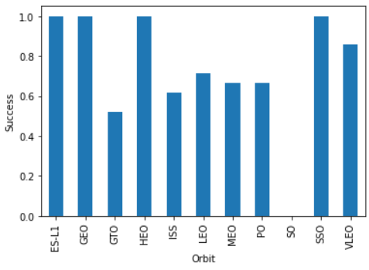
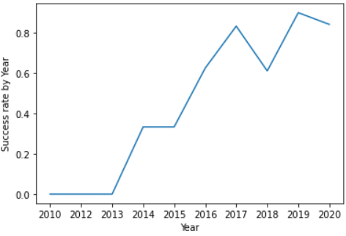
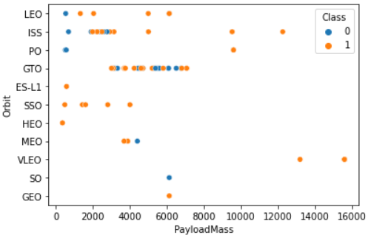
EDA with Data Visualization
Link
Scatter plot can suggest relationships (correlation) between variables.
PayloadMass vs Flight Numbers
Flight Numbers vs Lunch Site
Payload vs Launch Site
Flight Number vs Orbit type
Payload vs Orbit type
Bar Graph is used to compare data among categories.
Success vs Orbit type
Line plot is used to track changes over short and long periods of time.
Launch success vs Years

Slide 12
EDA with SQL
Link
SQL queries performed:
Display the names of the unique launch sites in the space mission
Display 5 records where launch sites begin with the string 'CCA’
Display the total payload mass carried by boosters launched by NASA (CRS)
Display average payload mass carried by booster version F9 v1.1
List the date when the first successful landing outcome in-ground pad was achieved.
List the names of the boosters which have success in drone ships and have payload mass greater than 4000 but less than 6000
List the total number of successful and failed mission outcomes
List the names of the booster_versions which have carried the maximum payload mass. Use a subquery
List the records which will display the month names, failure landing_outcomes in drone ship ,booster versions, launch_site for the months in the year 2015.
Rank the count of successful landing_outcomes between the date 04-06-2010 and 20-03-2017 in descending order.

Slide 13
Build an Interactive Map with Folium
Link
Maps objects added to folium map centred on NASA, Texas
Marker all lunch sites with the corresponding name
Marker the success (green) and failed (red) lunches for each site
Line with the distances between a launch site to its proximities (coastline, railways, highways)
These maps help to understand the problem and the data. It is an easy way to visualize the situation.

Slide 14
Build a Dashboard with Plotly Dash
Link
Dashboard has
Dropdown which allows selecting one specific launch site or all.
Pie plot that shows total success/failure for the selected launch site.
Rangeslider that allows choosing a mass payload range.
Scatter plot of success vs payload showing their relationship.

Slide 15
Predictive Analysis (Classification)
Link
Data Preparation
Load preprocessed data
Normalization data
Divide into train and test data
Model Preparation
Selecting 4 models (Logistic Regression, SVM, KNN and Tree Classification)
Set parameters for each model, and use GridSearchCV
Training models
Model Evaluation and comparison
Get the best parameters for each model
Calculate accuracy with test dataset and plot confusion Matrix
Comparison of the accuracy of the models

Slide 16
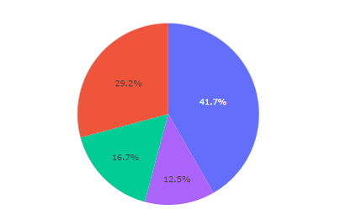
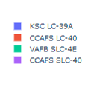
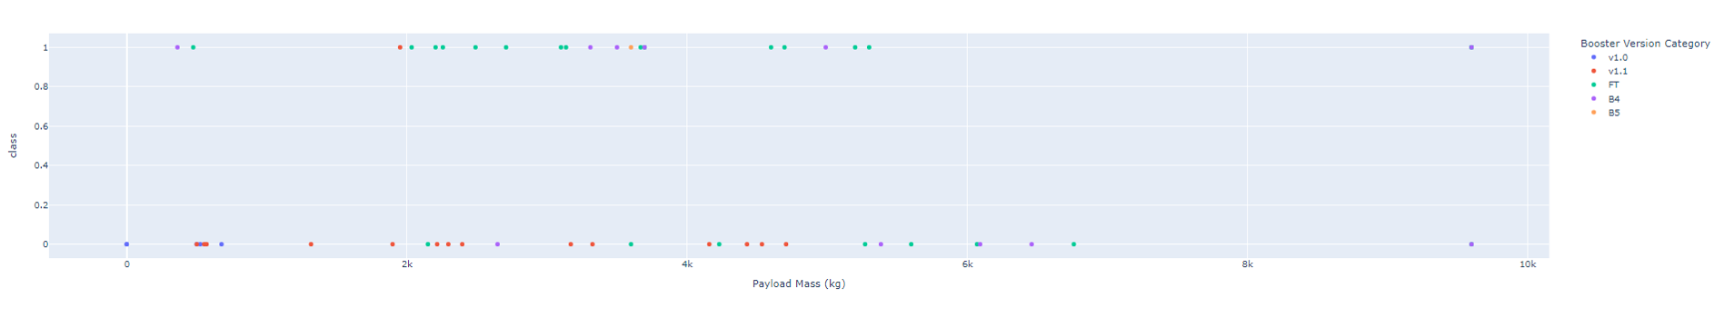
Results
All models have similar accuracy (80 %)
The evolution of success rates show an increase over the years
Different launch sites have different success rates
Success pie chart all sites
Examples from dashboard

Slide 17

Section 2

Slide 18
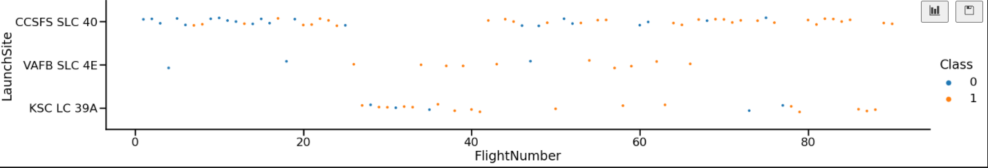
Flight Number vs. Launch Site
It is observed that the success rate increases, which is more clear in the launch site CCSFC SLC 40

Slide 19
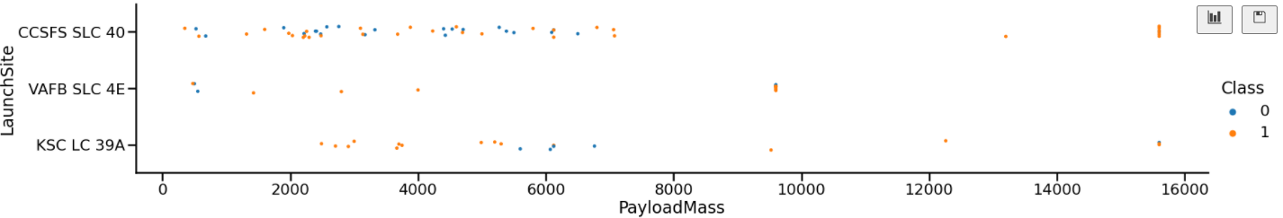
Payload vs. Launch Site
For some launch sites, the heavier payload, the larger the successful landing. However, if the payload is too large, there are some failed landings.

Slide 20
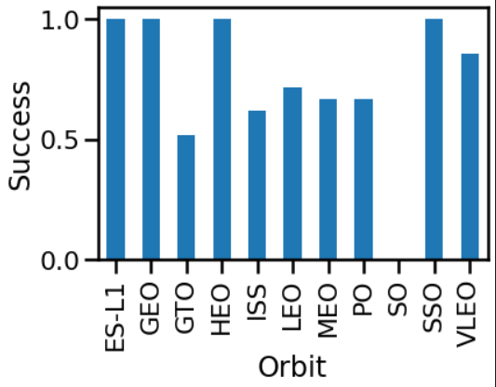
Success Rate vs. Orbit Type
This graph shows the success rates for different orbit types.
Some of them (ES-L1, GEO, HEO, and SSO) have the highest values.

Slide 21
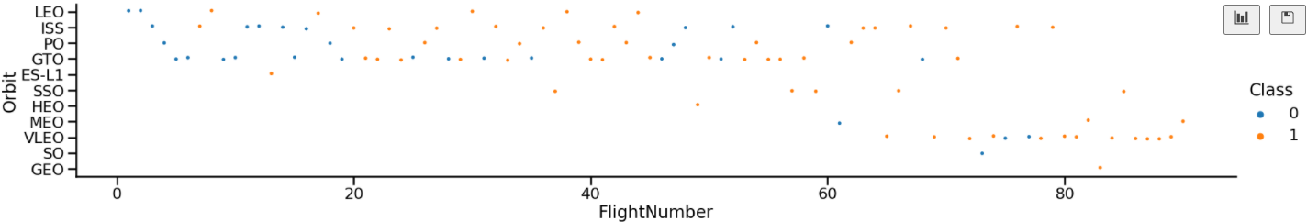
Flight Number vs. Orbit Type
It is observed that the success appears related to the number of flights in the case of LEO orbit, and on the other hand, there seems to be no relationship between both variables in the GTO orbit.

Slide 22
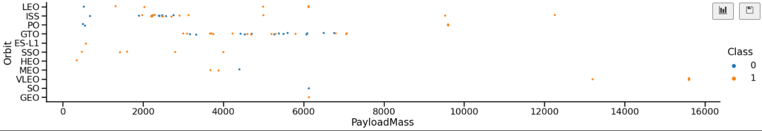
Payload vs. Orbit Type
The payload has an impact on the success at least for some orbits. Heavy payloads are more successful for Polar, Leo, and ISS orbits

Slide 23
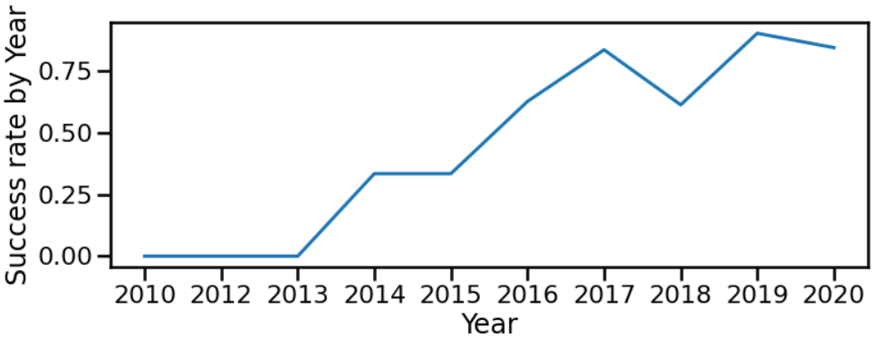
Launch Success Yearly Trend
This graph shows the evolution of the success, and from 2013 it increases over the years.

Slide 24
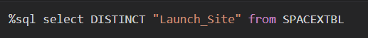
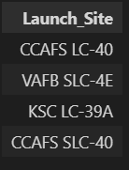
All Launch Site Names
SQL query
Results
This query lists all distinct variables in the column “Lauch site” from the table SPACEXTBL.

Slide 25
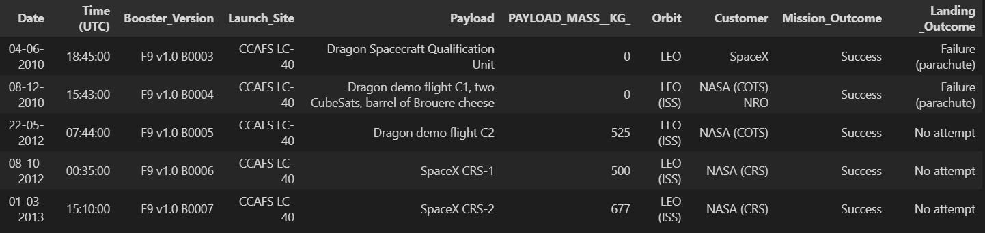
Launch Site Names Begin with 'CCA'
SQL query
Results
This query finds firstly all row where column “Launch_site” starts with CCA and “limit 5” indicates to list only the first 5 lines.

Slide 26
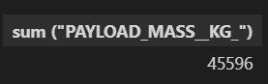
Total Payload Mass
SQL query
Results
This query returns the sum of payloads masses filtering where the costumer is NASA (CRS).

Slide 27
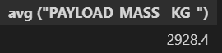
Average Payload Mass by F9 v1.1
SQL query
Results
This query returns the average of payloads masses filtering where the booster version is F9 v1.1

Slide 28
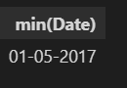
First Successful Ground Landing Date
SQL query
Results
This query returns the oldest successful landing considering only ground landing.

Slide 29
Successful Drone Ship Landing with Payload between 4000 and 6000
SQL query
Results
This query returns the Bosster Veersion filtering by two columns. Only returns Booster version where Landing Outcomes is Success drone ship, and where Payload masses in between 4000 and 6000 kg.

Slide 30
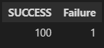
Total Number of Successful and Failure Mission Outcomes
SQL query
Results
In this case subqueries were used. The first one counts the success, the second one the failure, using the filter “where”.

Slide 31
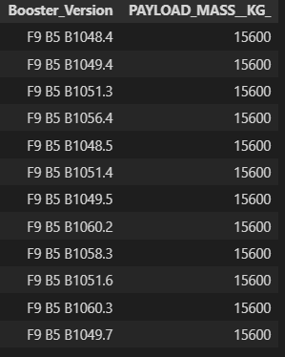
Boosters Carried Maximum Payload
SQL query
Results
In this case, two subqueries were used again. The main is for listing the Boster_version and Payload masses, and the second one is for filtering the maximum payload.

Slide 32
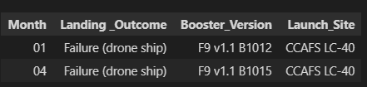
2015 Launch Records
SQL query
Results
This query returns the month, landing outcome, booster version, and launch site where the landing was unsuccessful and took place in 2015.

Slide 33
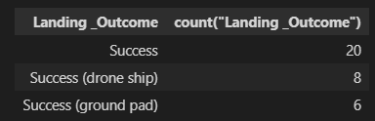
Rank Landing Outcomes Between 2010-06-04 and 2017-03-20
SQL query
Results
This query returns the Landing outcomes and their counts for dates between 04-06-2010 and 20-03-2017, also it groups them by the landing outcome, and finally shows them in decreasing order.

Slide 34

Section 3

Slide 35
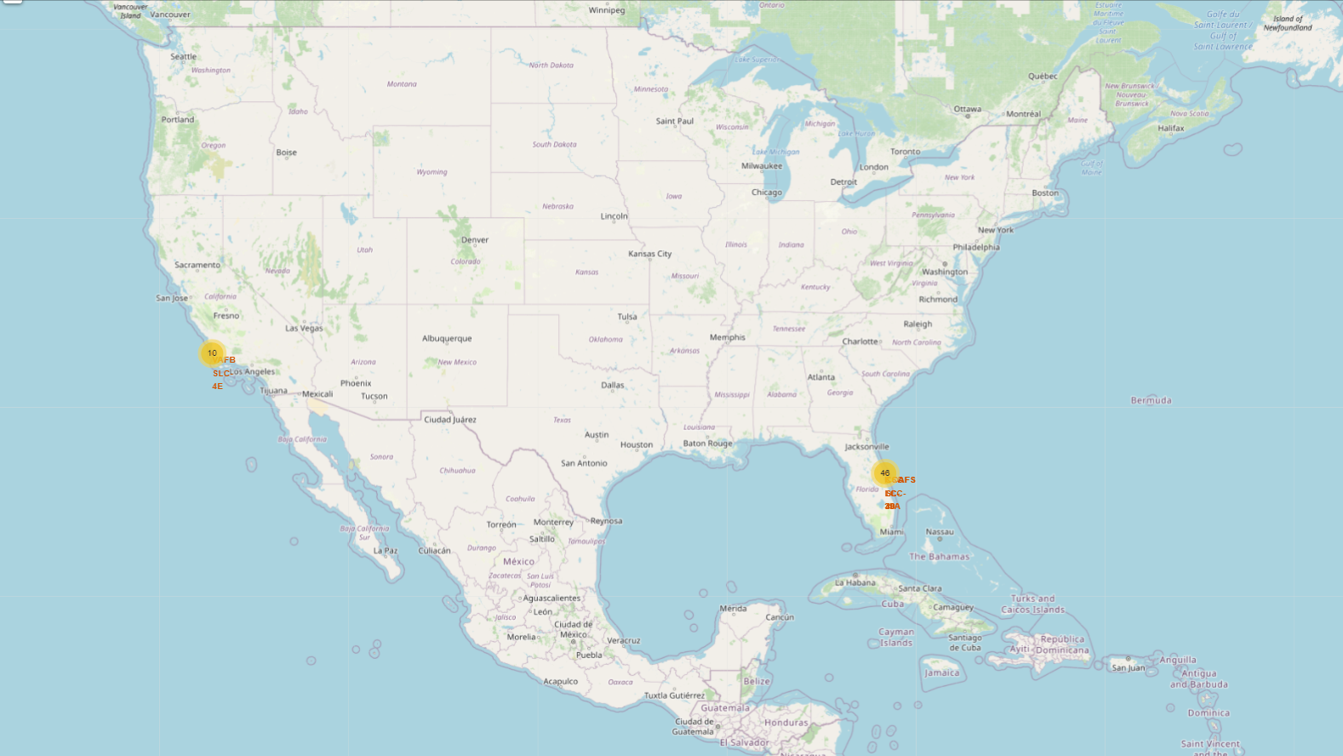
Folium Map- Stations
It can be observed the Space X launch sites on both coast.

Slide 36
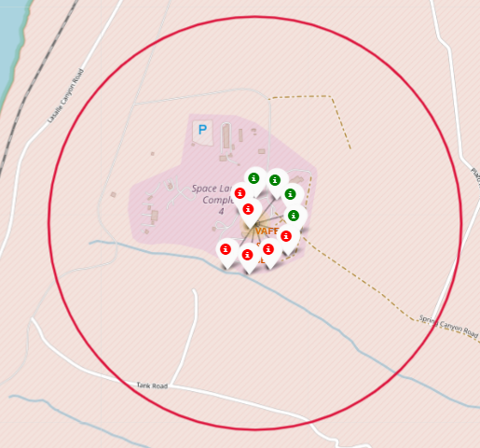
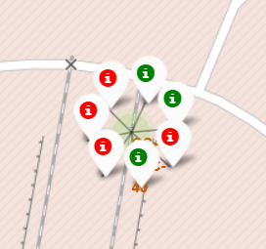
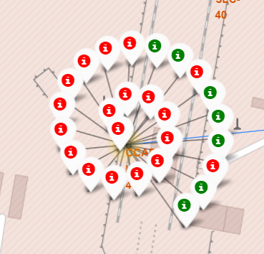
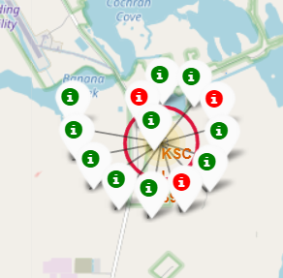
Folium Map- Succeed and Failure in color markers
VAFB SLC-4E
CCAFS SLC-40
CCAFSLC-40
KSC LC-39A
Examples for each launch site were the succeed is indicated in green and failure in red

Slide 37
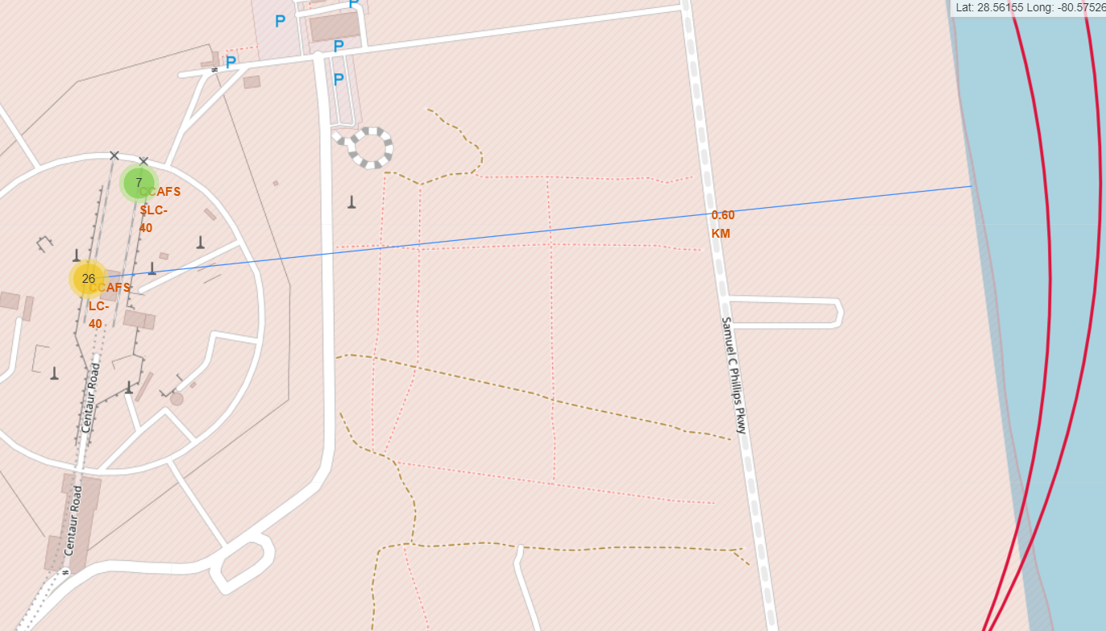
Folium Map- Distance
Examples of the distance between CCAFS LC-40 launch site and the coast (0.6 km).

Slide 38

Section 4

Slide 39
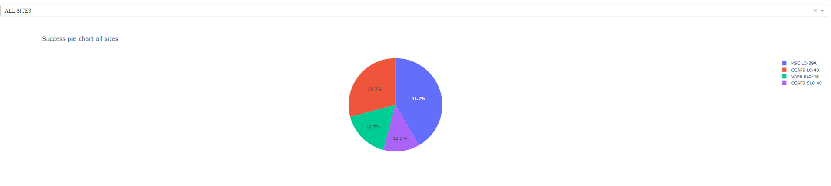
Dashboard Total success by site
It can be seen that the KSC LC 39A has the best performance.

Slide 40
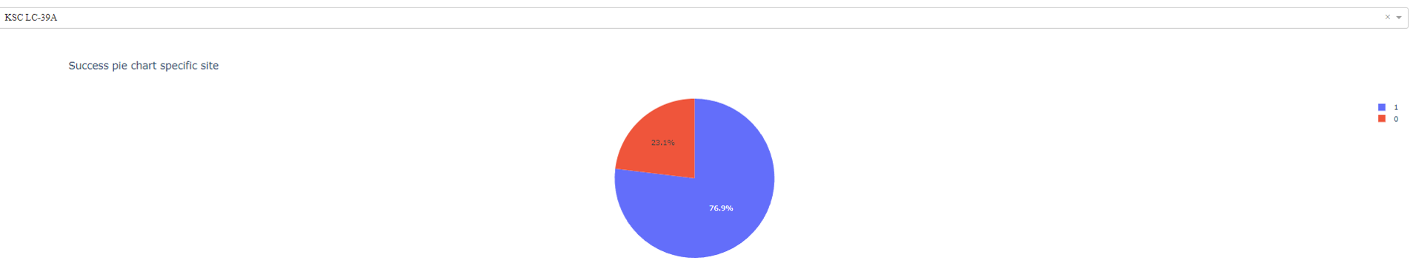
Dashboard Total Success for site KSC LC 39A
On KSC LC 39A, the 76.9 % of launches were successful and 23.1 % unsuccessful.

Slide 41
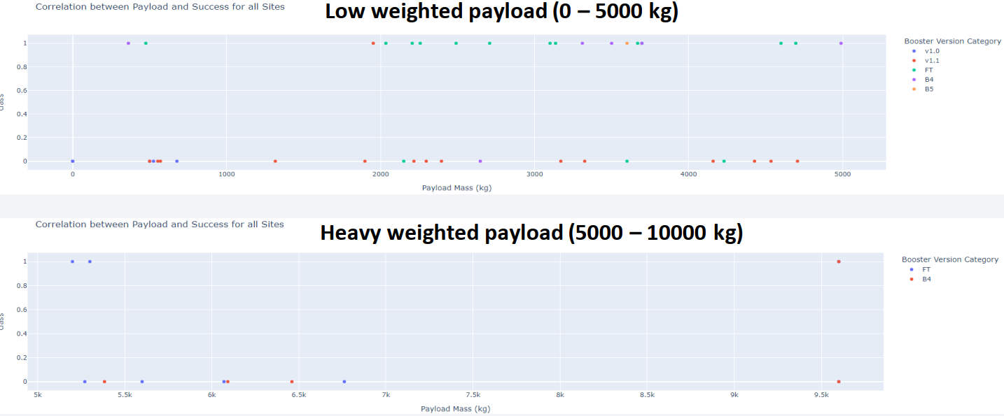
Dashboard Payload vs Launch outcome for all sites
The success rate is better for low weighted payload.

Slide 42

Section 5

Slide 43
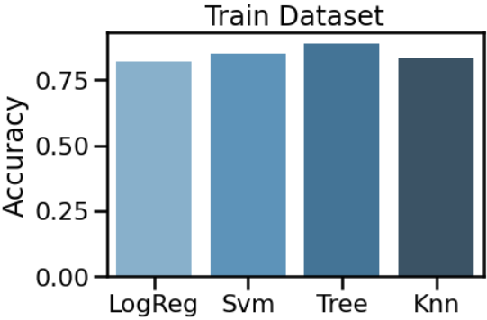
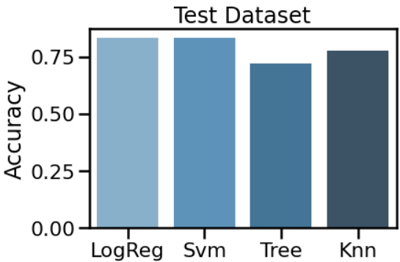
Classification Accuracy
Based on this data the models have a similar accuracy (train Dataset)
LogReg and Svm have slightly higher accuracy than Tree and Knn

Slide 44
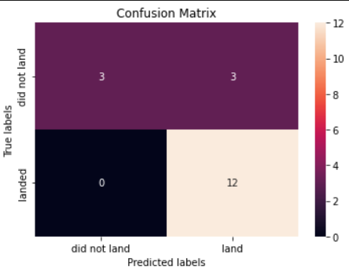
Confusion Matrix
False Positive
This is the confusion Matrix for the SVM model.
The problem with this model is the false positives.

Slide 45
Conclusions
From this analysis it can be concluded that the success of landing depends on many factors such as the launch site, the orbit, and the number of previous launches.
ES-L1, GEO, HEO, and SSO are the orbits with the highest values of success.
In general terms, the success rate is better for a low-weighted payload.
An increase in the success rate since 2013 was observed.
4 models were used to predict future missions (Logistic Regression, SVM, KNN, and Tree Classifier), and LR and SVM have a slight best accuracy (on test datasets)

Slide 46


